Slide 1
Chain Replication
Lecturer: Ngo Huy Bien
Software Engineering Department
Faculty of Information Technology
VNUHCM - University of Science
Ho Chi Minh City, Vietnam
nhbien@fit.hcmus.edu.vn

Slide 2

Objectives

Slide 3

Contents
Chain Replication.

Slide 4

References

Slide 5
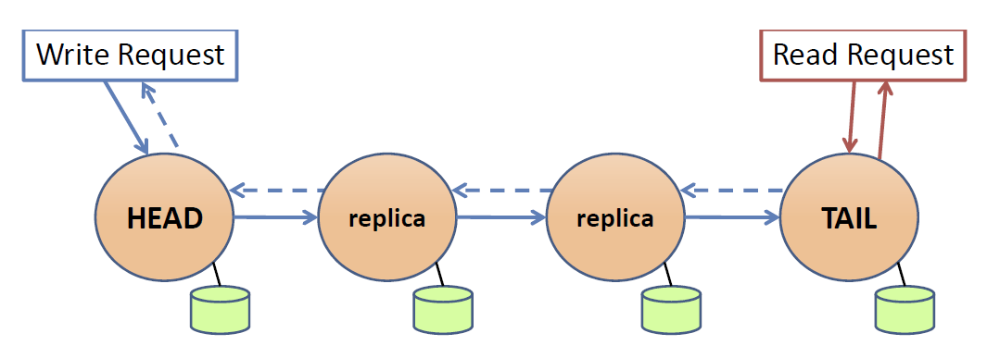
Chain Replication
S1, S2, S3, S4
S1 is "head", S4 is "tail"
Writes:
Client sends to head
Forwarded down the chain, in order
Each server overwrites old data with new data
Tail responds to client
Reads:
Client sends to tail
Tail responds (no other nodes involved)

Slide 6
Pros and Cons
If client gets write reply, data is safe if even one server survives.
and linearizable.

Slide 7
Intuition for Linearizability of CR
When no failures, almost as if the tail were the only server.
Head picks an order for writes, replicas apply in that order,
so they will stay in sync except for recent (uncommitted) writes.
Tail exposes only committed writes to readers.
Failure recovery, briefly.
Good news: every replica knows of every committed write.
But need to push partial writes down the chain.
If head fails, successor takes over as head, no committed writes lost.
If tail fails, predecessor takes over as tail, no writes lost.
If intermediate fails, drop from chain, predecessor may need to re-send recent writes.

Slide 8
Why is CR Attractive (vs. Raft)?
Client RPCs split between head and tail, vs Raft's leader handles both.
Head sends each write just once, vs Raft's leader sends to all.
Reads involve just one server, not all as in Raft.
Situation after failure simpler than in Raft

Slide 9
Limitation
why can't 2nd node take over as head if it can't reach the head?
Partition -- split brain -- the 2nd node must wait patiently.
How can we safely make use of a replication system that can't handle partition?
A single "configuration manager" must choose head, chain, tail.
Everyone (servers, clients) must obey or stop.
Regardless of who they locally think is alive/dead.

Slide 10
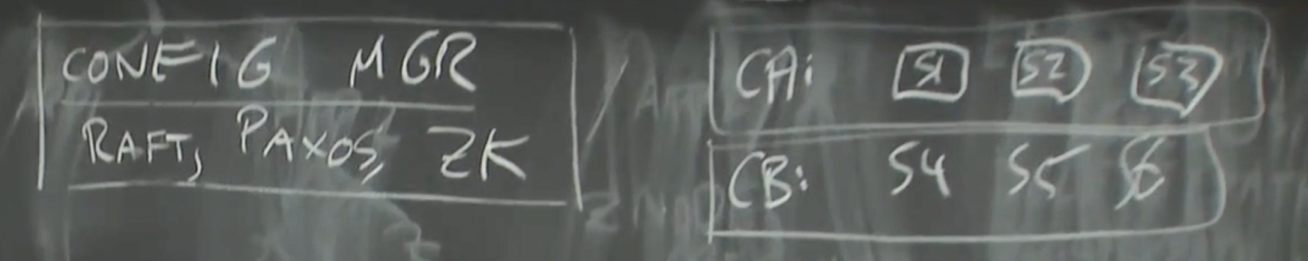
Configuration Manager
A configuration manager is a common and useful pattern.
It's the essence of how GFS (master) and VMware-FT (test-and-set server) work.
Usually Paxos/Raft/ZK for config service,
data sharded over many replica groups,
CR or something else fast for each replica group.

Slide 11

Thank You & See You Again

